Slide 1
Individual Officiating Techniques (IOT)
Signals & Reporting
Created by Warren Poncsak & Martha Bradbury
2019 – Ver. 4.0
Notes:
Slide Time: 1 min
Total Presentation: 35 min
Location: Classroom with large space
Needs:
Activity Sheet
Pens, paper
Flipchart/whiteboard, marker
Electronic device for recording (phone, camera, iPad, etc.)
Whistle
Actions:
Introduce the topic for this session
Introduce yourself as an educator
Review the expectations for the day and how the course will flow

Slide 2
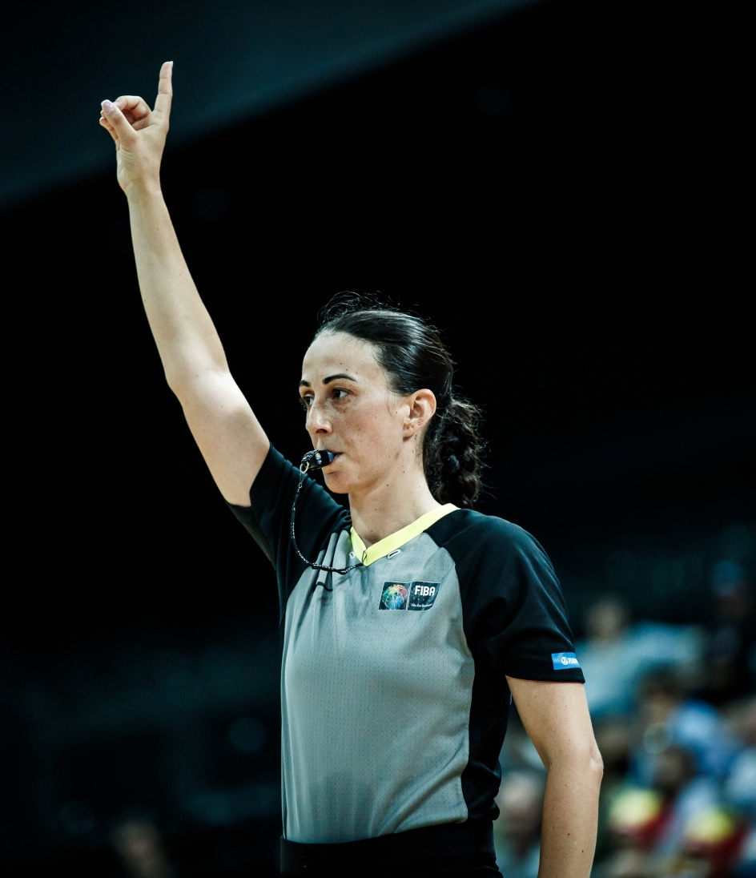
LEARNING OUTCOMES
To identify the different phases and techniques of having strong and decisive signals as part of court presence
To use official signals in a professional and clear way
Practice using official signals
2019 – Ver. 4.0
Notes:
Slide Time: 1 min
Actions:
Review the learning outcomes with the group

Slide 3
Provides clear, accurate and consistent communication
Displays professional attitude and professionalism
Creates a strong perception
Provides a trusted and accepted refereeing image
Personal habits, preferences, and/or use of unapproved signals shows a lack of understanding and
undermines the above
Why is it important to use official signals?
TO ATTAIN THE ABOVE …
PRACTICING SIGNALS IS HIGHLY NECESSARY
2019 – Ver. 4.0
Notes:
Slide Time: 5 min
Actions:
Have the officials create groups of 2 or 3
In their groups, have them introduce themselves and discuss: Why is it important to use official signals? (1 min)
Have the officials create a new group and repeat the process 2 – 3 more times (2/3 min)
Educator can set conditions for the groups: e.g. someone you have not officiated with before or pair officials with 10+ experience with those who are less experienced
Click to reveal the key points (1 min)
Ensures clear and consistent communication
FIBA is the governing body that defines the official signals
It’s a professional sign and attitude to use only the official signals
When communicating decisions with signals it is good to remember that the use of signals creates a strong perception among people watching the referees
Signals are one piece of the overall package of providing a trusted and accepted refereeing image
Personal habits & preferences only demonstrate a lack of understanding & professional attitude
Practical signals is highly necessary

Slide 4
SIGNAL STANDARDS
Level 1
Uses approved signals sometimes and verbalizes at point occasionally
Level 2
Uses approved signals frequently and verbalizes at the point usually
Level 3, 4, 5
Uses approved signals always and verbalizes at the point always
2019 – Ver. 4.0
Notes:
Slide Time: 30 sec
Actions:
Review the standards for using signals at each of the various NOCP levels
Educator should explain what using signals looks like at the NOCP 3,4,5 level

Slide 5
ACTIVITY #1 – SIGNALS CHECKLIST
Use authorized FIBA signals
Rhythm
Start and a stop
Finish signal, freeze and count “one - two”
Strong, Sharp, Visible and Decisive
Use appropriate hand for direction
Every call with same standard
Less is more
Verbal support
2019 – Ver. 4.0

Slide 6
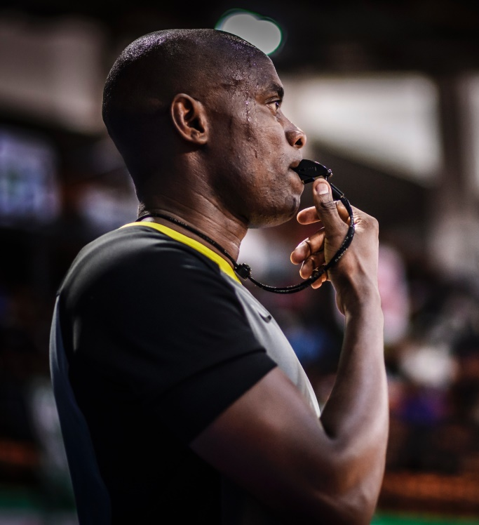
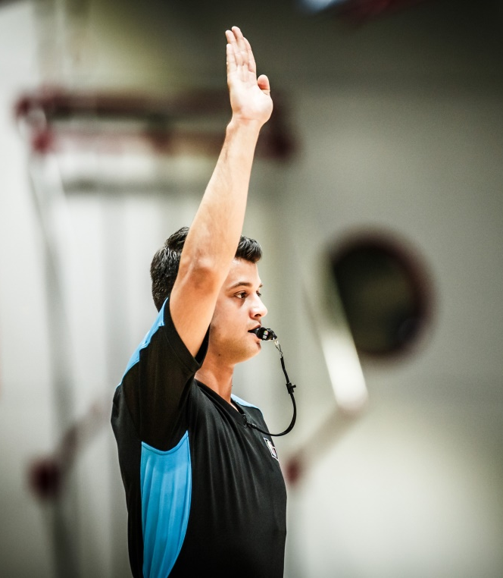
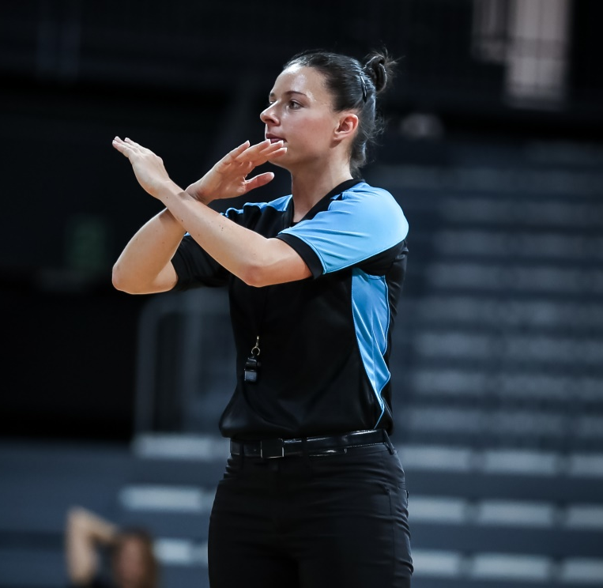
ACTIVITY #2 – SIMON SAYS “SIGNALS”
+
+
2019 – Ver. 4.0
Notes:
Slide Time: 2 min
Needs: whistle
Actions:
Educator should demonstrate the appropriate signal process for a violation
Blow whistle
Stop the clock
Have the officials practice whistling and stopping the clock for a violation
Educator should demonstrate the following signals first and have the officials mimic the signals after (similar to ‘Simon says’ or ‘Copycat’)
Out of bounds
Travel
Double dribble
3 second violation

Slide 7
REPORTING STANDARDS
Level 1
Always verbalizes CN, usually verbalizes NC, and sometimes uses approved signals.
C
N
N
C
Colour
Number
Nature
Consequence
Level 2
Always verbalizes CNN, usually verbalizes C, and frequently uses approved signals.
Level 3, 4, 5
Always verbalizes CNNC and always uses approved signals.
2019 – Ver. 4.0
Notes:
Slide Time: 1 min
Actions:
Review the process for reporting to the table:
Colour
Number
Nature
Consequence - the consequence is usually colour of the team to get it with direction of play or number of shots or AP (alternating possession)
Educator should explain the importance of “Whistle Tone” in reporting:
This speaks to the pitch, which should be clear and crisp
It is a means of communication because different circumstances during the game require different whistle tones and lengths
Mastering the proper tones can really enhance an official’s game
Educator should provide an example of what reporting a call looks like at the 3,4,5 Level

Slide 8
CHECKLIST FOR REPORTING TO THE SCORER’S TABLE
Move with purpose
Visual contact with table
Stop, set and breathe
Consistent rhythm/cadence
Colour Number Nature and Consequence
Foul reported matches what happened on play
Verbal support
2019 – Ver. 4.0

Slide 9
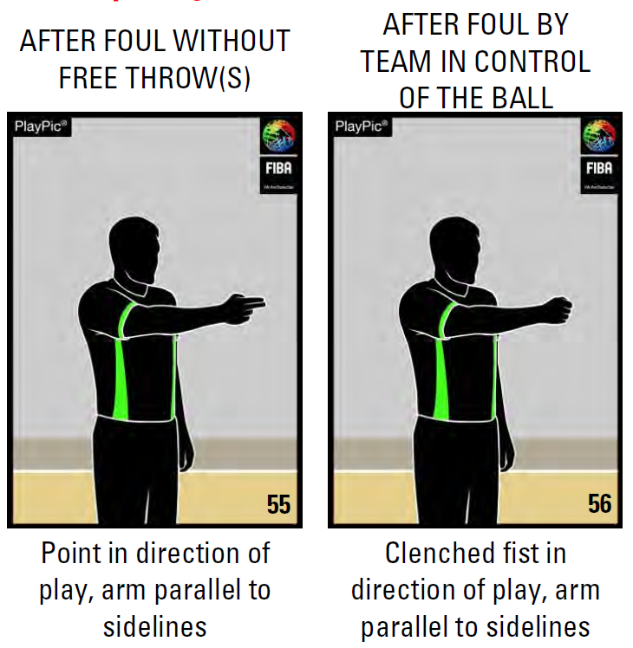
FIBA SIGNALS – FOULS
2019 – Ver. 4.0
Notes:
Slide Time: 1 min
Actions:
Review the following foul signals with the group

Slide 10
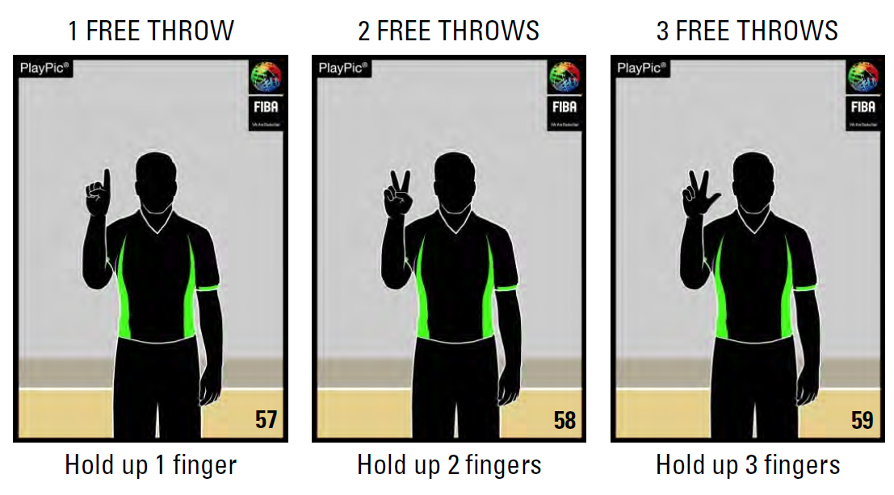
FIBA SIGNALS – FOULS
2019 – Ver. 4.0
Notes:
Slide Time: 1 min
Actions:
Review the following foul signals with the group

Slide 11
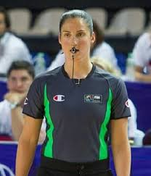
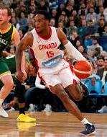
ACTIVITY #3 -
SIGNALS
(FOULS)
2019 – Ver. 4.0
Notes:
Slide Time: 5 min
Needs: Activity Sheet, whistle
Actions:
Have the officials get into groups of 3, consisting of: official, offender, defender
Have each group select a type of foul from the bag
Have the groups practice calling out fouls at the point of the foul
Once they have completed the sequence, have the official jog in place for 30 seconds and perform a table report (based on CNNC)
Level 1: CN
Level 2: CNN
Level 3,4,5: CNNC
Have the groups select another foul from the bag
Have the officials rotate through the positions and practice calling more fouls

Slide 12
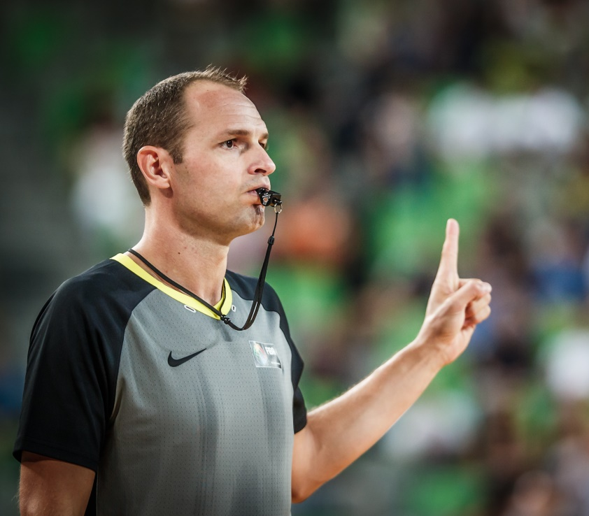
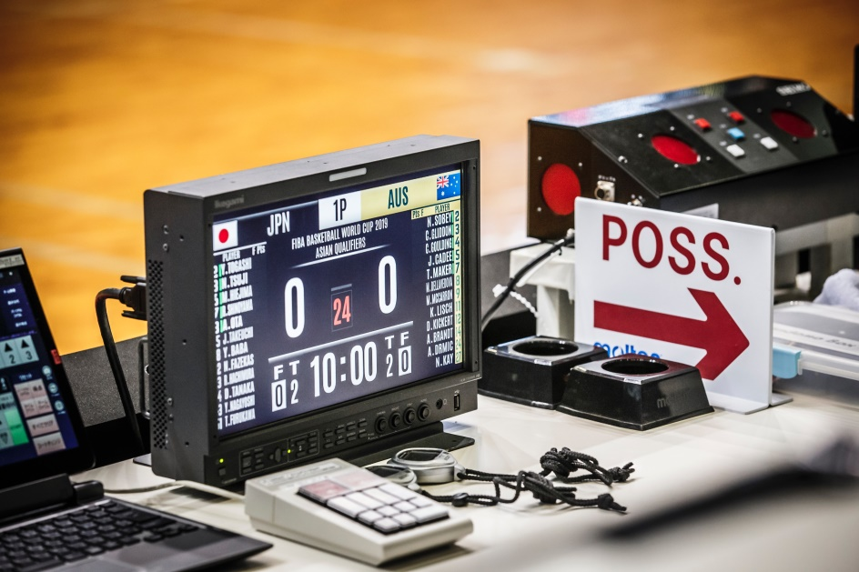
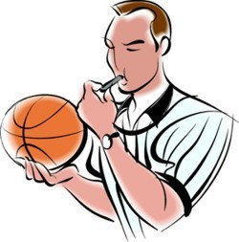
ACTIVITY #4 – FOUL REPORTING
2019 – Ver. 4.0
Notes:
Slide Time: 4 min
Provide simple scenarios for all levels and complex double fouls ONLY for levels 3.4.5
Needs: Activity Sheet, video recording, whistle
Actions
In the same groups from the previous activity, have the officials practice reporting a foul to the table (1 min)
Have each group pick a scenario from the bag
Have one official in the group record the reporting process
Have the groups watch the video back and provide feedback to the official who is practicing
Have the official practice the reporting process again (including the feedback from the group)
Have the officials rotate through the roles and repeat the activity – a new scenario should be picked each time (3 min)
NOTE: Every official should have the opportunity to practice reporting to the table and receiving feedback

Slide 13
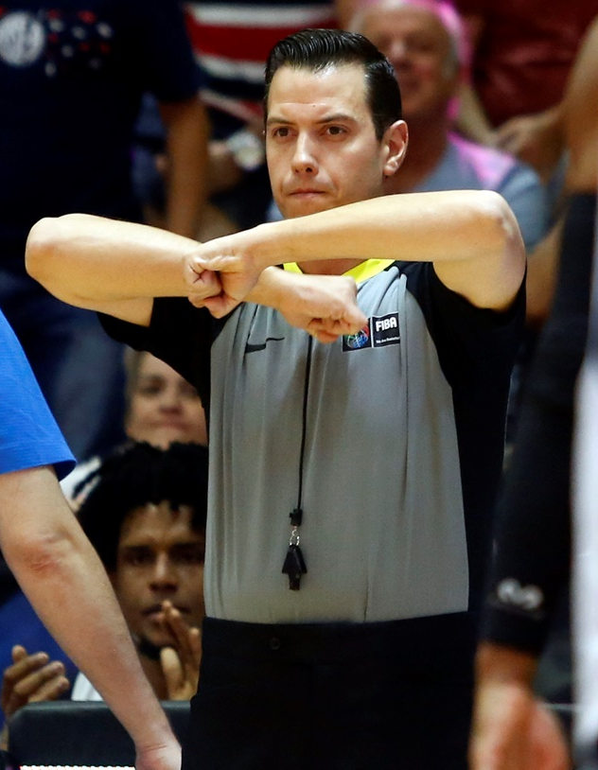
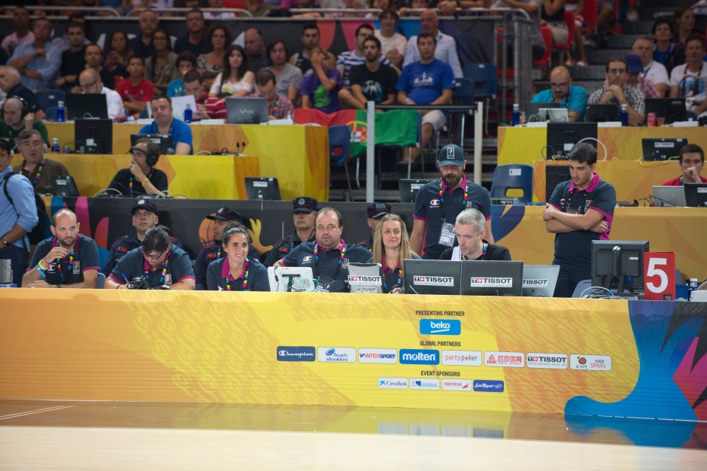
ACTIVITY #5 – DEMO
2019 – Ver. 4.0
Notes:
Slide Time: 4 min
Needs: video recording, whistle
Actions:
Have the groups (from the previous activity) volunteer to demonstrate the correct procedure for foul reporting
Each group can recommend a person to present at the front of the class.
Educator should record the groups and replay the video on the screen for immediate feedback
Have the officials vote with a thumbs up (if done correctly) or a thumb down (if done incorrectly)

Slide 14
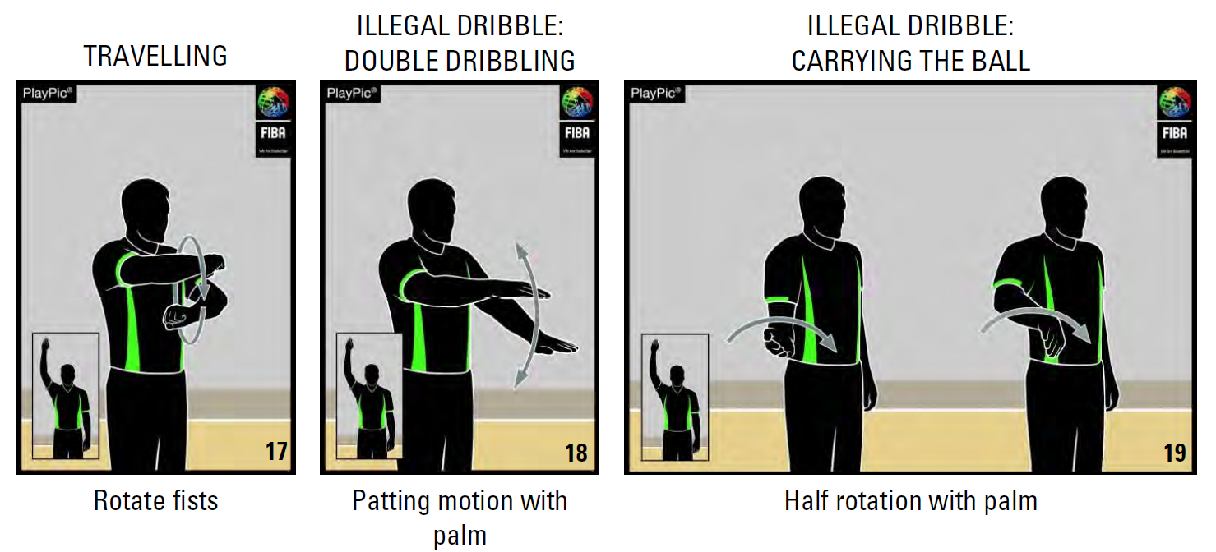
FIBA SIGNALS - VIOLATIONS
2019 – Ver. 4.0
Notes:
Slide Time: 10 sec
Actions:
Educator should review the following foul signals with the group and remind them to review the rule book

Slide 15
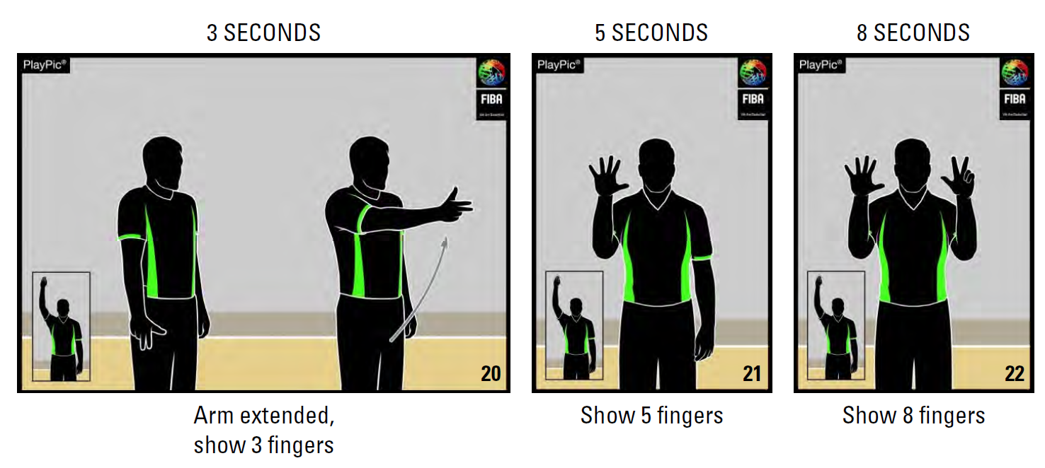
FIBA SIGNALS - VIOLATIONS
2019 – Ver. 4.0
Notes:
Slide Time: 10 sec
Actions:
Educator should review the following foul signals with the group and remind them to review the rule book

Slide 16
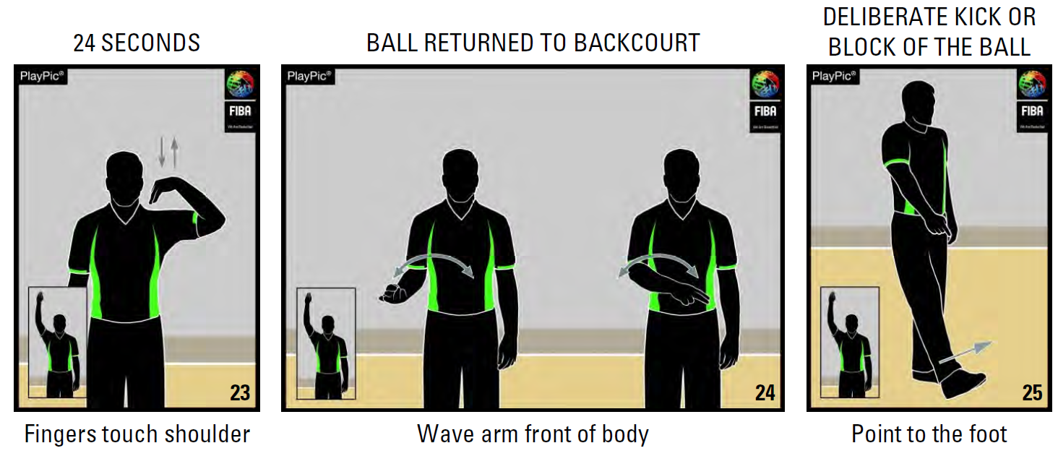
FIBA SIGNALS - VIOLATIONS
2019 – Ver. 4.0
Notes:
Slide Time: 10 sec
Actions:
Educator should review the following foul signals with the group and remind them to review the rule book

Slide 17
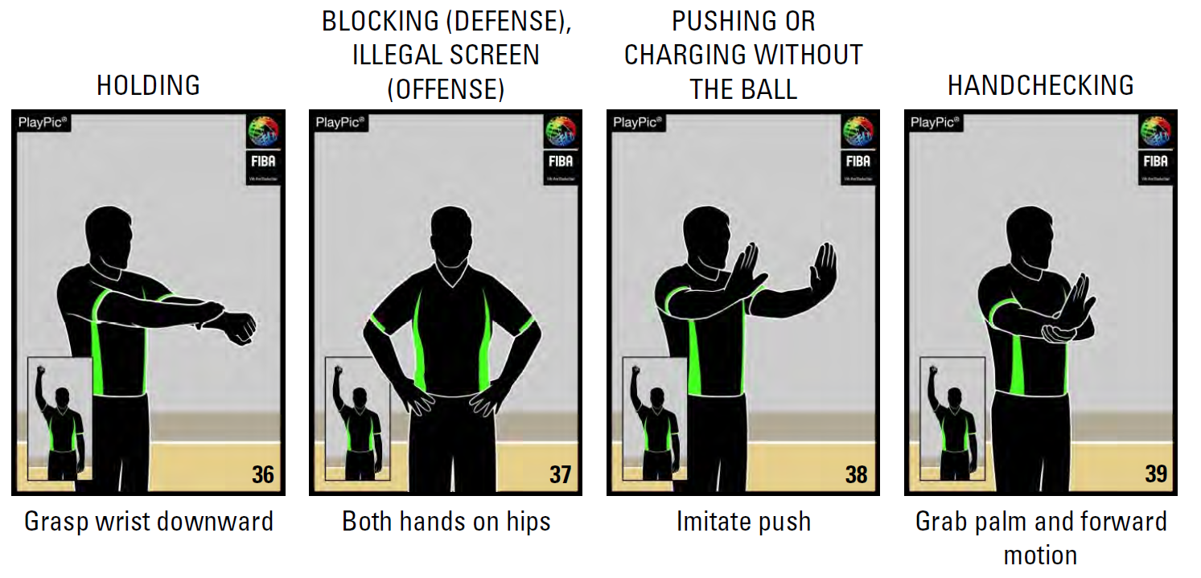
FIBA SIGNALS - FOULS
2019 – Ver. 4.0
Notes:
Slide Time: 10 sec
Actions:
Educator should review the following foul signals with the group and remind them to review the rule book

Slide 18
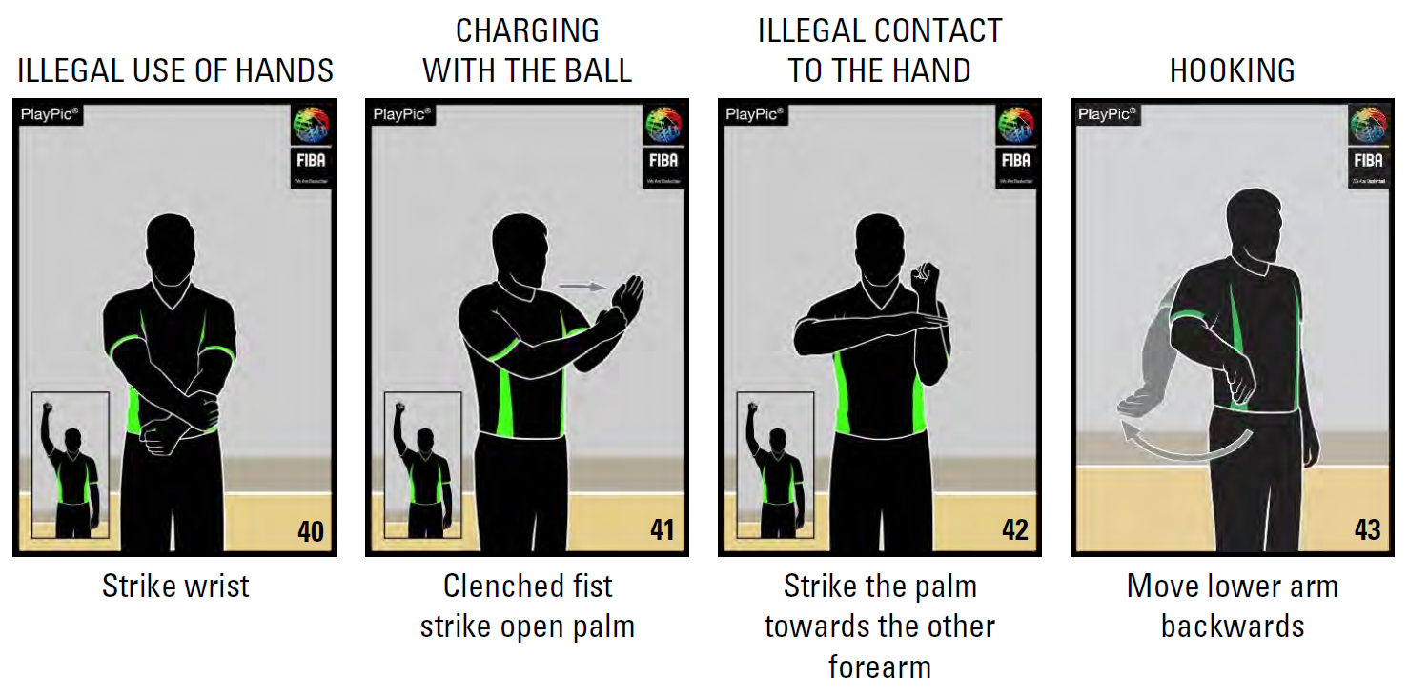
FIBA SIGNALS - FOULS
2019 – Ver. 4.0
Notes:
Slide Time: 10 sec
Actions:
Educator should review the following foul signals with the group and remind them to review the rule book

Slide 19
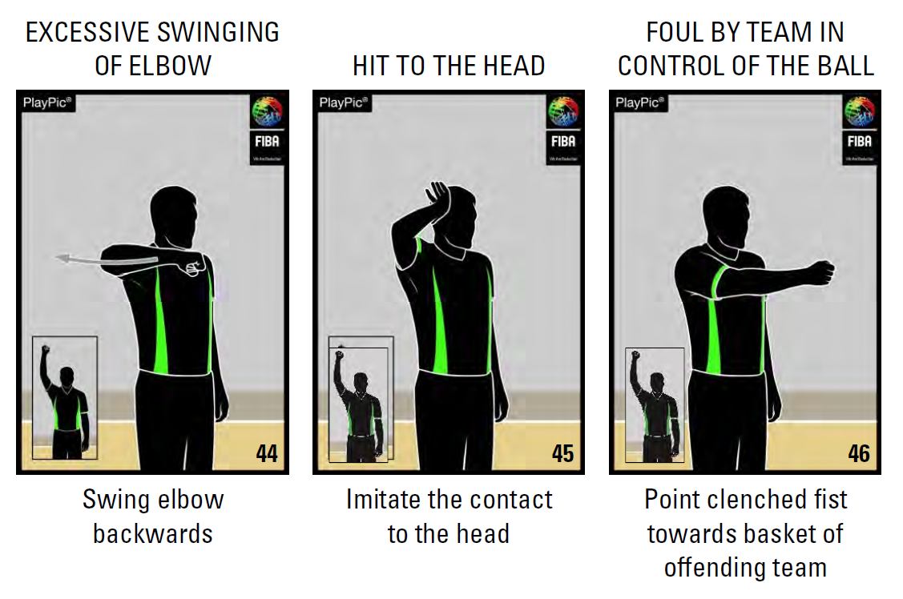
FIBA SIGNALS - FOULS
2019 – Ver. 4.0
Notes:
Slide Time: 10 sec
Actions:
Educator should review the following foul signals with the group and remind them to review the rule book

Slide 20
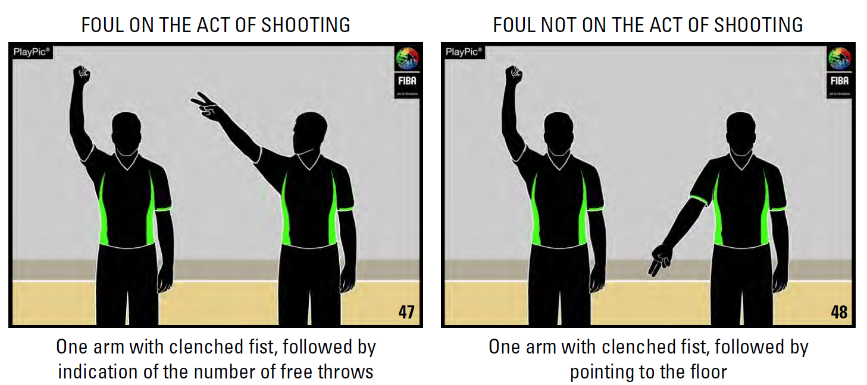
FIBA SIGNALS - FOULS
2019 – Ver. 4.0
Notes:
Slide Time: 10 sec
Actions:
Educator should review the following foul signals with the group and remind them to review the rule book

Slide 21
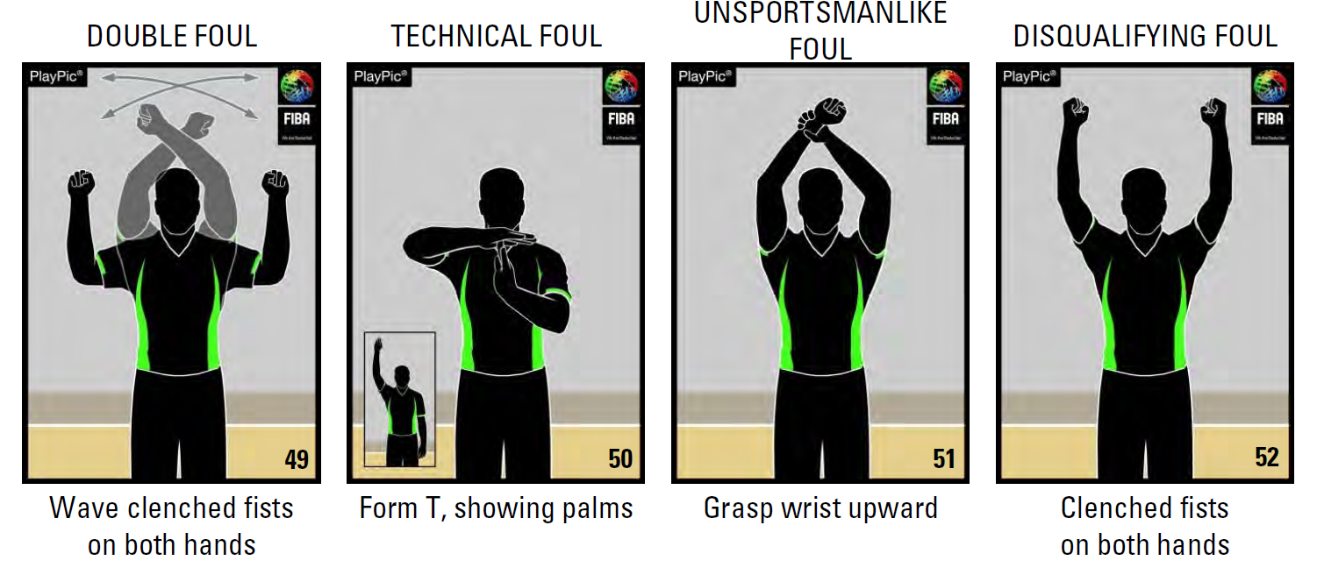
FIBA SIGNALS - FOULS
2019 – Ver. 4.0
Notes:
Slide Time: 10 sec
Actions:
Educator should review the following foul signals with the group and remind them to review the rule book

Slide 22
REFLECTION
STOP
START
CONTINUE
To effectively communicate my signals and reporting of calls I will…
Conviction, Confidence, Calmness
2019 – Ver. 4.0
Notes:
Slide Time: 1 min
Actions:
Have the group identify actions they will take to effectively communicate their signals and reporting
Educator should emphasize: Conviction, Confidence and Calmness

