Slide 1
Individual Officiating Techniques (IOT)
Distance and Stationary
Created by Reed Scott, Jim Walsh & Jake Steinbrenner
Notes:
Slide Time: 2 min
NOTE: All videos in this presentation have been embedded. In the slide show, click the image to be directed to the video on YouTube.
Total Presentation Time: 35 min
Location: Classroom + Court
Needs:
Paper, pens
Flipchart, markers
Begin with classroom – defining the concepts. Then move to group discussion to achieve unanimity and flesh out questions. Follow up with further elaboration of the concepts through PPT, visuals and video. Finally move to gymnasium for hands on demonstrations and live examples.
Actions:
Introduce the topic for this session
Introduce yourself as a educator
Review the expectations for the day and how the course will flow

Slide 2
LEARNING OUTCOMES
Introduce key concepts
Understand the impact of maintaining a proper distance from the play and being stationary when making the call
Officials will be expected to understand these concepts as complementary to other IOTs and adopt them into their on-court skill set
Notes:
Slide Time: 1 min
Introduce, educate and have officials demonstrate the optimal stationary position and distance from the play for 2PO and 3PO mechanics.
Actions
1. Review the Learning Objectives for this IOT
2. Ask the group what they would like to get out of the module
3. Outline 3 things you want to accomplish with this module:
a. Introduce the concepts
b. Educate on distance & being stationary
c. Demonstrate optimal stationary positions & distance from the play in 2PO & 3PO mechanics

Slide 3
INTRODUCTORY PROPOSTION
What does the optimal stationary position and distance to play look like?
What is the correlation between call accuracy as well as readiness for the play & distance from the play?
❓
When is a call most accurate?
Notes:
Slide Time: 3 min
Actions:
1. Think, Pair, Share activity
Have the officials reflect independently on the questions (30 sec)
After 30 seconds have them pair up with another official and discuss their answers (1 min)
2. Discuss the answers as a group:
There is a high correlation between call accuracy as well as readiness for the next play by having the optimal distance from the play
Call accuracy increases when the official has anticipated the best position and is stationary when making a decision

Slide 4
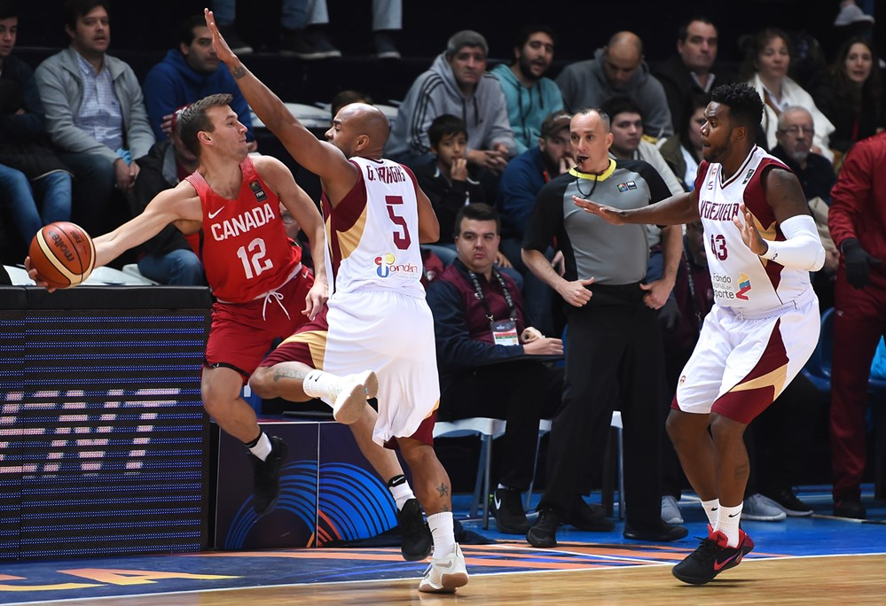
DISTANCE
When refereeing the play, it is critical to maintain an appropriate distance from the play
Distance = how far away from or close to the play an official is
Notes:
Slide Time: 1 min
Actions:
Review the definition of distance in a game
a. Distance is how far away or close to the play you are
b. When refereeing it is critical to maintain an appropriate distance from the play

Slide 5
VISUALIZATION EXERCISE
Visualize you’re watching the game from court side. Then visualize you are watching the same game from the upper deck of the stands.
Does the speed of the game appear the same?
You see that the players’ movements look slower than at court level
Notes:
Slide Time: 1 min
Actions:
Have the officials complete the visualization exercise

Slide 6
ACTIVITY #1:
DISTANCE IMPACTS
What happens when you are too close or too far away from the play?
With proper distance:
possibility of an “emotional call” or reaction decreases
movements look slower
can maintain a wide angle with more players in the field of vision
able to see the big picture
Notes:
Slide Time: 3 min
Needs: flipchart, marker
Actions:
Divide the group into two and provide each side with chart paper. Have one group work on brainstorming what happens when you are too close to the play and the other write down what happens when you are too far away from the play
Bring the groups back together and have them present to each other
Review the following points that emphasize when a referee has proper distance from the play (3-6 meters):\
Possibility of an ’emotional call’ or reaction decreases
They can maintain a perspective as movements look slower
They can maintain a wide angle, which increases the possibility of seeing more players in the field of vision
They can see the big picture (next plays to follow, control the clocks, identify where partners are)

Slide 7
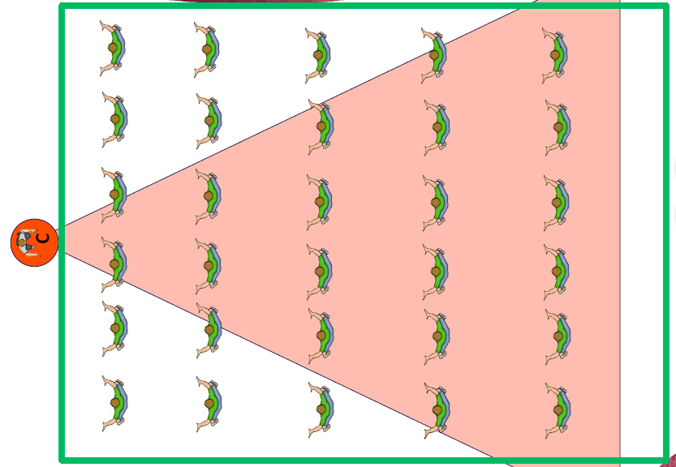
DISTANCE EXAMPLE
Notes:
Slide Time: 1 min
Actions
Educator should explain the diagram:
Proper distance creates a wider angle and the referee is able to have more players in the field of vision at the same time
Example in the first row = 2 players, second row = 3 players, third row = 4 players etc. In total the official can see 26 players out of 36 (72%)

Slide 8
ACTIVITY #2 – WHAT DO YOU SEE?
Find a partner
Each partner draws a simple picture on a piece of paper
Whilst your eyes are closed, trade your picture with your partner and bring the picture up to your face (must touch your nose)
Open your eyes – Describe what you see
Move the picture 2 inches away from your face – Describe what you see
Move the picture to arms length – Describe what you see
Notes:
Slide Time: 3 mins
Need: pen, paper
Actions:
Have officials partner up with someone near them. Each partner draws a simple picture on a blank piece of paper
a. Partners trade pictures and while keeping their eyes closed bring the picture up to their face (touching their nose)
b. Have them open their eyes and describe what they see
c. Move the paper about 2 inches away from the face and describe again
d. Extend the arm halfway, describe the picture, then all the way and describe what they can see
e. Emphasize that as the paper gets farther away you are able to describe a more accurate picture

Slide 9
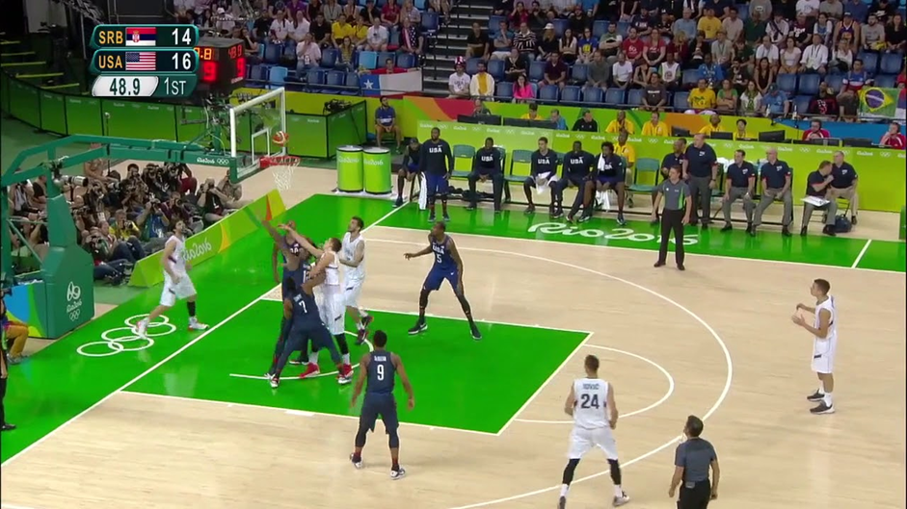
ANGLES, VISION, MATCHUPS
Notes:
Slide Time: 3 mins
Actions:
Use the following prompting questions to discuss the picture on the slide, taking note of the distance spacing of the Lead on the baseline, Centre on the far side, and Trail near the side:
Do all 3 officials have correct angles and a view of players in their primary field of vision?
The C is in optimal position for this play and is best to also observe flight of the ball.
The T's head position shows him watching the ball instead of engaged contact by Blue 7 and the White rebounder.
Do the Lead, Centre & Trail also have views of players in their secondary field of vision?
There is only one action area (at the rim in the restricted space) on this rebounding play and with the proximity of the players multiple players are within field of vision
What are/identify the player matchups in each of the above fields of vision? What corrections, if any, could be made?
It appears that there are 5 players (3 white – player out-of-bounds and two on perimeter and 2 blue – player closest to C and player closest to T) that are not actively engaged in rebounding;
If blue 9 and/or white 24 became involved then they would be T’s responsibility;
C has primary responsibility for blue and white player on C’s side;
L and T are focused on illegal contact and displacement by blue 7 and white player actively competing for rebound from behind
What is the general shape for 3PO?
Triangle
Ask the group if there is any corrections that could be made, if any.

Slide 10
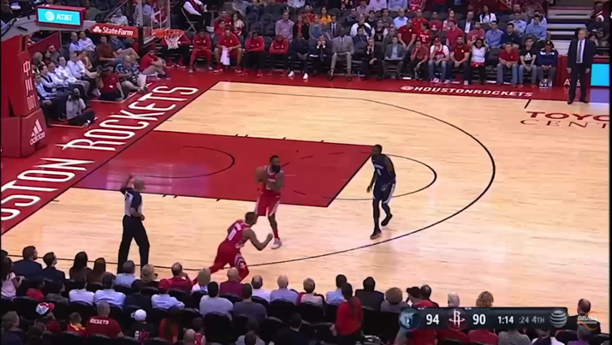
SPACING
Notes:
Slide Time: 3 min
In slide show, click on the image to be directed to video. Video also available: https://youtu.be/yfr0FV3dpEg
Actions:
PLAY the video clip, and have officials take notes on the officials’ spacing
Trail administers throw-in and maintains proper Distance as the play begins in the backcourt
As he progresses up court he gets ahead of the ball and drifts onto the court. As the play enters the front court the T is too far onto the court and loses his secondary coverage of the match up to his right
Furthermore, as play progresses in the frontcourt, instead of moving towards the sideline and increasing Distance to see more players, he loses his optimal spacing and gets in the way of the pass
2. Have them share their notes with a partner (30 secs)
3. Discuss spacing, positioning, and field of vision of the officials in the play with the entire group (1 min)

Slide 11
WHY IS DISTANCE IMPORTANT?
Key to the positioning of officials in Lead and Trail (2PO) and Lead, Trail and Center (3PO)
Judging optimal distance to the play is fundamental to establishing correct angles and open looks
Finding the correct distance to the play increases with practice and experience
Notes:
Slide Time: 1 min
Actions:
Have the officials discuss why distance is important when officiating?
CLICK to reveal the bullets
Discuss any responses that were not mentioned by the officials

Slide 12
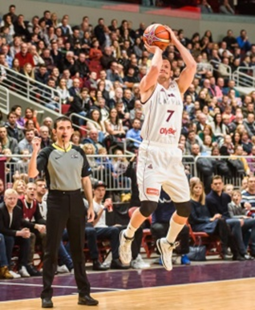
STATIONARY
Being stationary means staying in the same spot for a period of time
Often referees that are engaged with the play are not conscious of whether they are moving or not
Advantages of being stationary when making a decision:
Eyes not bouncing around
Increased concentration
Increased focus
Correct decisions are more likely
Notes:
Slide Time: 1 min
Actions:
Remind officials that in order to be stationary, there are a few key things to remember:
Get to the appropriate set up positions & be ready to accept the play
Be aware of the possible next play & use appropriate body positioning to anticipate the play
If a referee is stationary when he is making a judgment:
a) Eyes are not bouncing and focus and concentration increases
b) Thus a correct decision is more likely

Slide 13
STATIONARY, PURPOSEFUL MOVEMENT
AND ANTICIPATION
Being Stationary to make a decision does not mean officials are not expected to move with a purpose
Officials have to move to obtain optimal distance and angles
Anticipation is important so officials can be in the correct position when a decision is made (Call or No Call)
MOVE
OBSERVE
DECIDE
STOP
Notes:
Slide Time: 1 min
Actions:
1. Remind officials that in order to be stationary there are a few key things to remember:
Get to the appropriate set up position & be ready to accept the play
Be aware of the possible next play & use appropriate body positioning to anticipate the play
It is important that a referee must ‘Move’ to be in the right position to see the gap (this is different than position adjustment); and must do so as quickly as possible. ‘Stop’, ‘Observe’ and ‘Decide’.

Slide 14
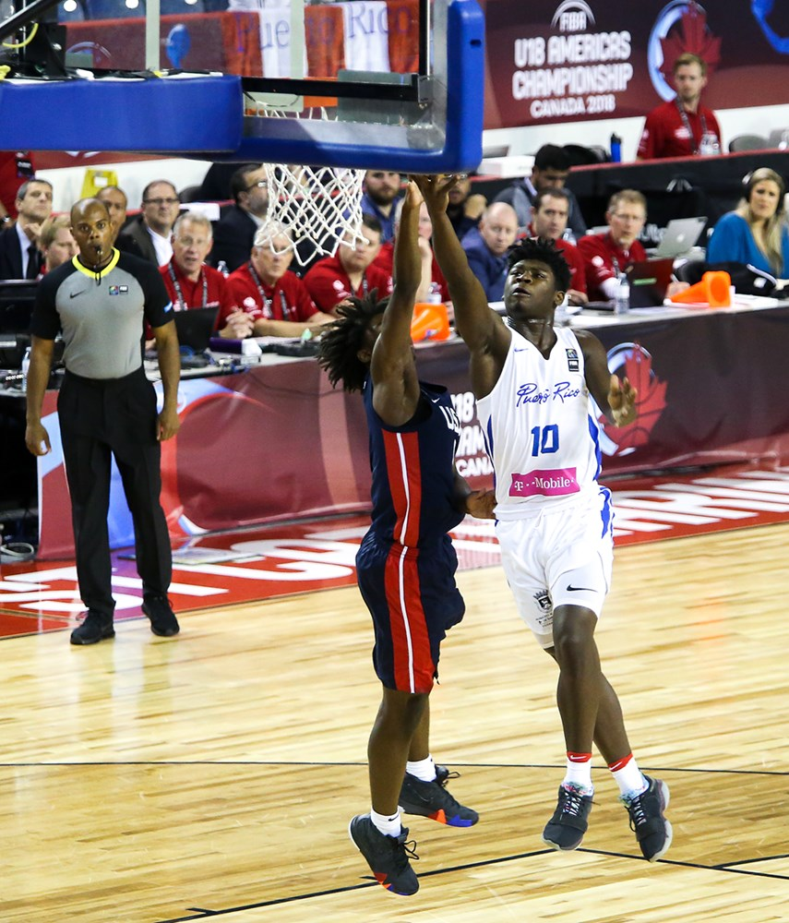
STATIONARY STANCE
Notes:
Slide Time: 1 min
Actions:
Ask the group: how would you describe the way the officials are standing?
Note officials appear relaxed, not rigid

Slide 15
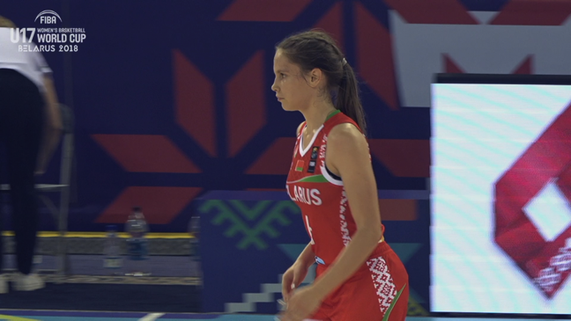
ACTIVITY #4 – PRACTICE!
Notes:
Slide Time: 5 mins
In slide show, click on the image to be directed to video. Video also available: https://youtu.be/QZ_7sfFqECo
On Court or in Classroom: Students will require proper gym shoes for practice sessions whether on court or in classroom
Practice includes a large group activity – referee drill to practice transition coverage through all 3 official positions – Lead, Trail, Centre
Actions:
Review distance & stationary concepts in the video on the slide. Can use the full video on this slide and/or following slide breaks full video down into 3 segments to highlight teaching points (1 mins)
At 5 sec on clip the Trail official is moving and close to play at point of contact/decision
On the shot, the Trail correctly adjusts her position with a cross-step to the left, but then does not anticipate rebound action by staying connected to the play and is too far away
On the throw-in after the basket, the new Trail correctly stays off the court initially, but then does not move to maintain optimal distance to get an open look
The Center official has optimal distance on the play but is moving (drifting) and does not anticipate helping in secondary coverage even though he has an open look
When on court officials will rotate through the positions as a play moves up and down the court (5 mins)
Have the officials create a group of 3 composed of a Lead, Trail and Centre
Have each group go down the court, making sure they focus on their transition coverage as they move from one end to the other (based on the play in the video
Educator should emphasize where each official should be positioned in the play
Have the groups rotate the positions (each official should get an opportunity to be the L, T or C)

Slide 16
1
2
VIDEO BREAKDOWN
Part 1
Part 2
Part 3
3
Notes:
Slide Time: 3 min
In slide show, click on the image to be directed to video. Video also available: https://youtu.be/fS5QDhKPnCk (Part 1), https://youtu.be/9G5tQWMh0Lo (Part 2), https://youtu.be/Tb1cMz-8JXU (Part 3)
Actions:
PLAY part 1 (1 min)
Ask a couple of the officials to share what happened in the video
ANSWER: - At 5 sec on clip the Trail official is moving and close to play at point of contact/decision
PLAY part 2 (1 min)
Ask a couple of the officials to share what happened in the video
ANSWER: - On the shot, the Trail correctly adjusts her position with a cross-step to the left, but then does not anticipate rebound action by staying connected to the play and is too far away
PLAY part 3
Ask a couple of the officials to share what happened in the video
ANSWER: - On the throw-in after the basket, the new Trail correctly stays off the court initially, but then does not move to maintain optimal distance to get an open look
- The Center official has optimal distance on the play but is moving (drifting) and does not anticipate helping in secondary coverage even though he has an open look

Slide 17
REFLECTION
Think about recent game examples where you were officiating or observed another official, too close or too far away from a play that may have led to a missed call.
START
STOP
CONTINUE
Notes:
Slide Time: 1 min
Both IOTs – Distance and Stationary may be overlooked or dismissed as obvious or elementary concepts
Bringing in a well-known official (expert or authority) to demonstrate can heighten attention and relevance of these two principles to achieving excellence as an official
Actions:
1. Have the officials write down a time they were too close or too far away from the play which lead to a missed call
a. Based on this situation, what would they stop, start, & continue doing

