Slide 1
FAKE A FOUL
2017 RULE & PROCEDURE
Version 2.0: 10 August 2017
OBR 2017

Slide 2
NOTE
This material is created by FIBA Referee Department and should not be edited unless using so called ”open template” without FIBA logo.
See document “FIBA_Powerpoint_Presentations” for details.
If you identify an error or a discrepancy in this material, please notify the FIBA Referee Department at refereeing@fiba.com.
FIBA Referee Department

Slide 3
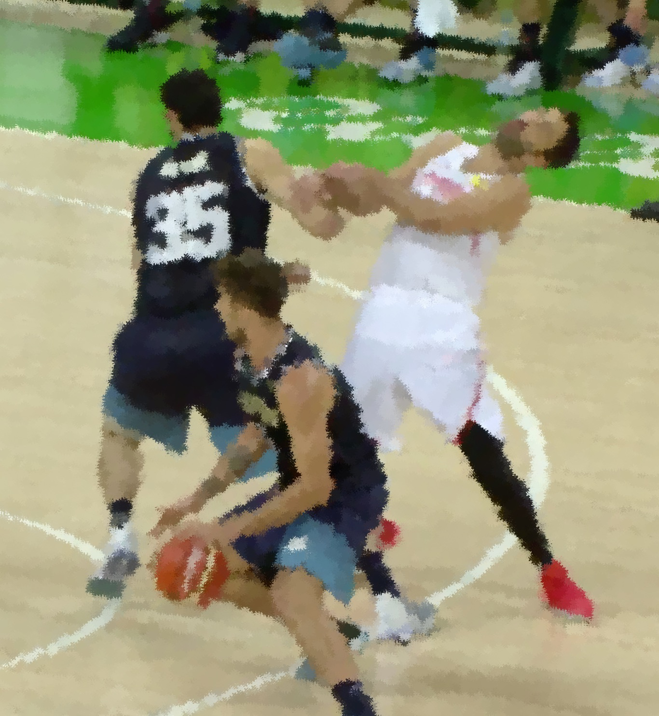
FAKE A FOUL
Definition
Fake is any action by a player (defence or offense) to pretend being fouled or to make theatrical exaggerated movements in order to create an appearance of being fouled and therefore gaining an unfair advantage.
Note:
Flop is a special type of the defender’s action (charge/block), but it is still a fake.

Slide 4
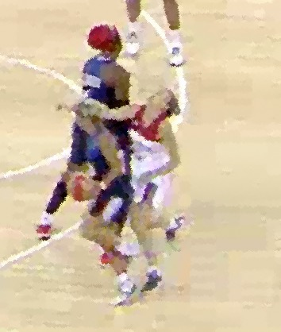
FAKING
Normally occurring in charging and screening situations.
Referees must know the game, the technical movements and tactics of the players to prevent players buying a fake.
This type of behavior does not fit within the spirit of sportsmanship and fair play.
Clean up the game – clean it early!

Slide 5
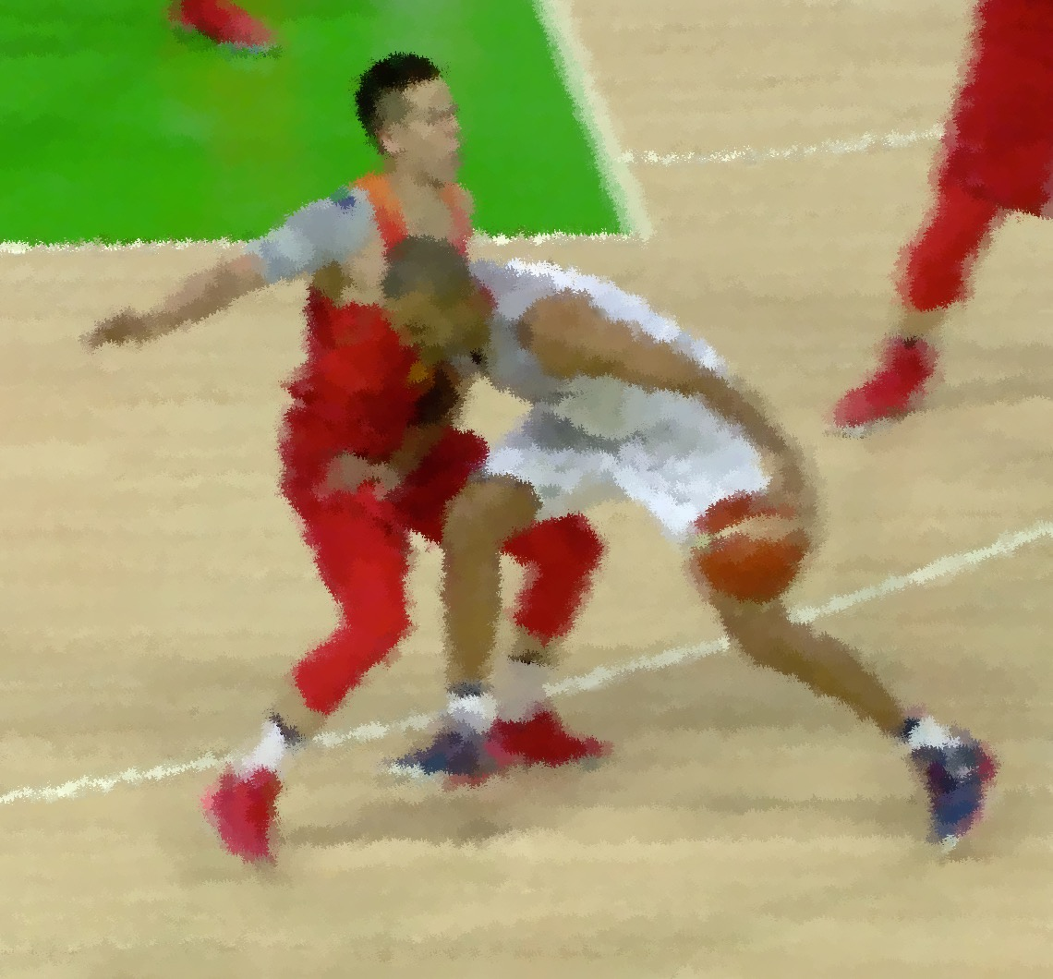
FAKING
Some players try to trick the referees by faking contact caused by an opponent, or by maximising marginal contact.
Some defensive players without a Legal Guarding Position (LGP), try to cause contact onto the torso and fall backwards flopping to draw an offensive foul.

Slide 6
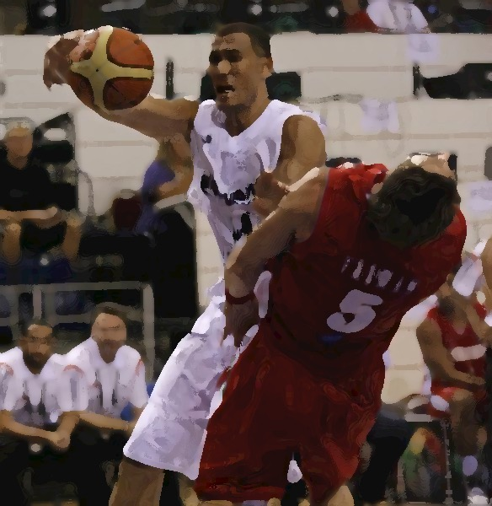
STANDARD (normal) FAKING
A player who fakes being fouled but does not generate any illegal contact and the referee shows the Fake signal:
A warning is given to the player and to the Head Coach during the next game interruption. This serves as a warning for that team.
Any repetition of faking by the same team is a Technical Foul
Possible to have 2 Fake warnings during the same play without game interruption.
Each team is entitled to one warning.

Slide 7
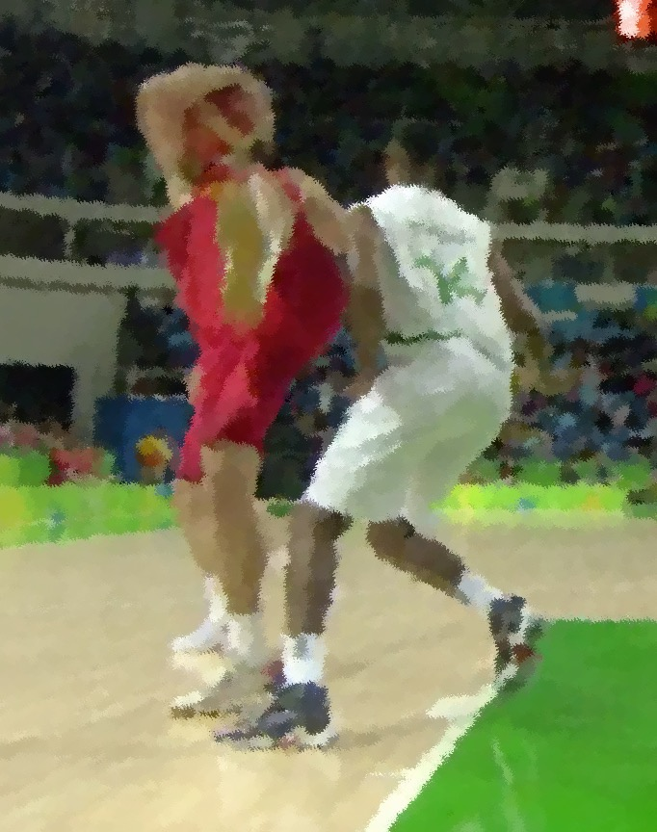
EXCESSIVE FAKING
A player who fakes excessively (without any contact with an opponent) and does not generate any illegal contact:
Direct Technical Foul (Unsportsmanlike behaviour)

Slide 8
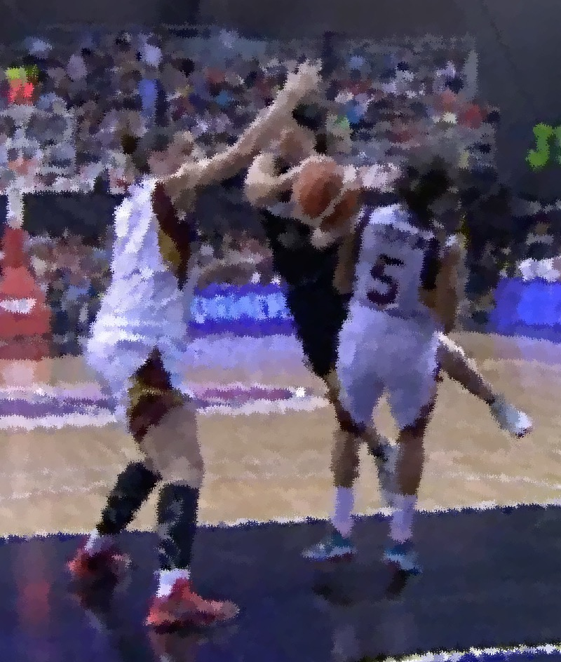
FAKING & ILLEGAL CONTACT
If a player:
fakes generating illegal contact, call the foul on the faker!
If there is a foul on the play, there cannot be a fake on the same play (no foul and warning on the same play).
Foul = No warning
No foul = Warning

Slide 9
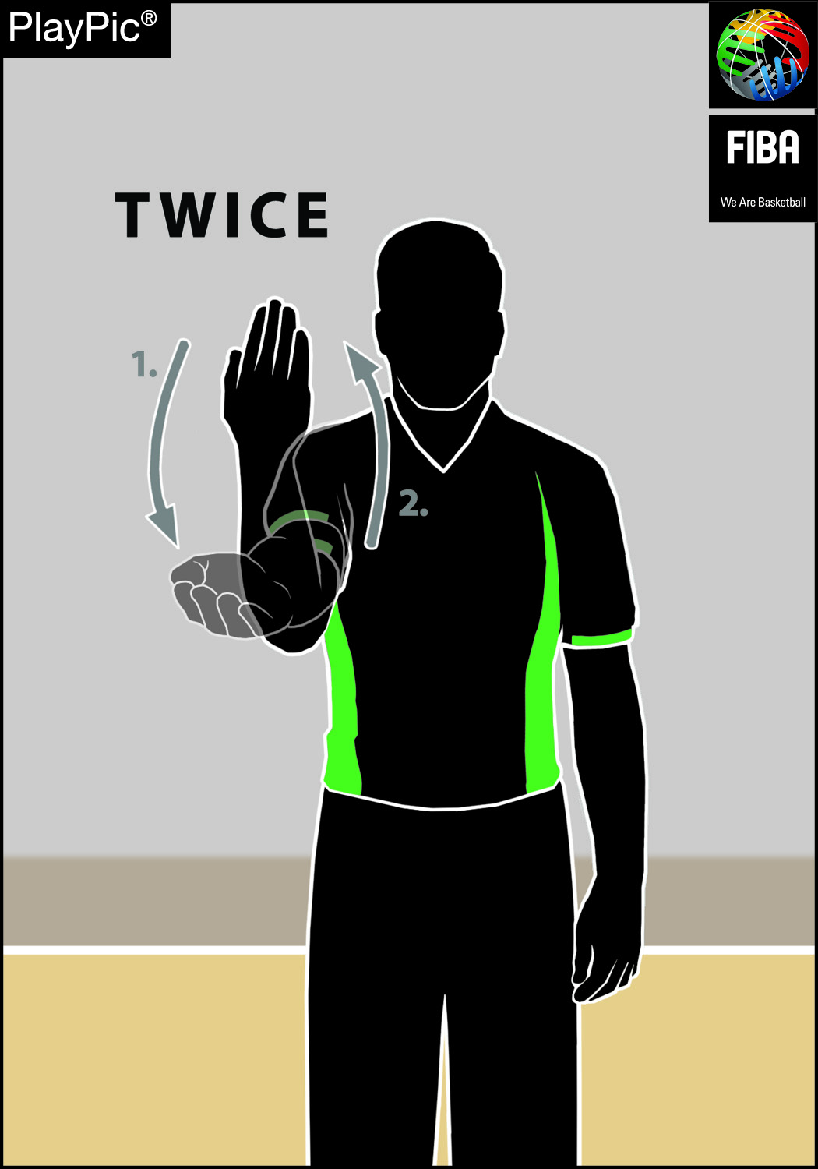
FAKE PROTOCOL / SIGNAL
Fake a foul signal
New “Raise-the-lower-arm”- signal twice (starting from the top)

Slide 10
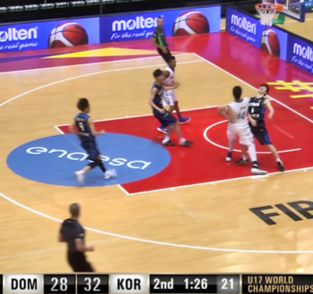
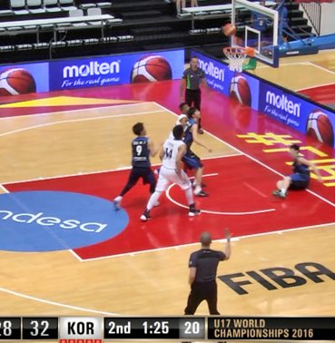
FAKE PROTOCOL Warning during the play
Protocol for the warning (during the play)
A fake action by the player during the play (no stoppage).
Show the “Raise-the-lower-arm”- signal to indicate the “fake action“.
Verbal support - for eg “white 8 fake“.

Slide 11
FAKE PROTOCOL Warning next interruption
Protocol for the warning (next stop clock period-game interruption)
Communicate the warning to the affected player and the coach plus co-official(s).
Show the “Raise-the-lower-arm”- signal and demonstrate the “ Technical Foul“ signal supported verbally.

Slide 12
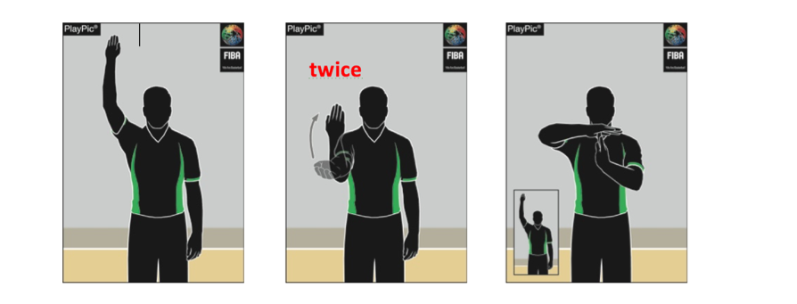
FAKE PROTOCOL Repetitive or excessive
On repetitive or on excessive* action resulting in a technical foul
Whistle with
“Stop-the-clock”-signal,
“Raise-the-lower-arm”- signal,
Followed by the “Technical foul” signal.
* No contact on the play or excessive action (faking)

Slide 13
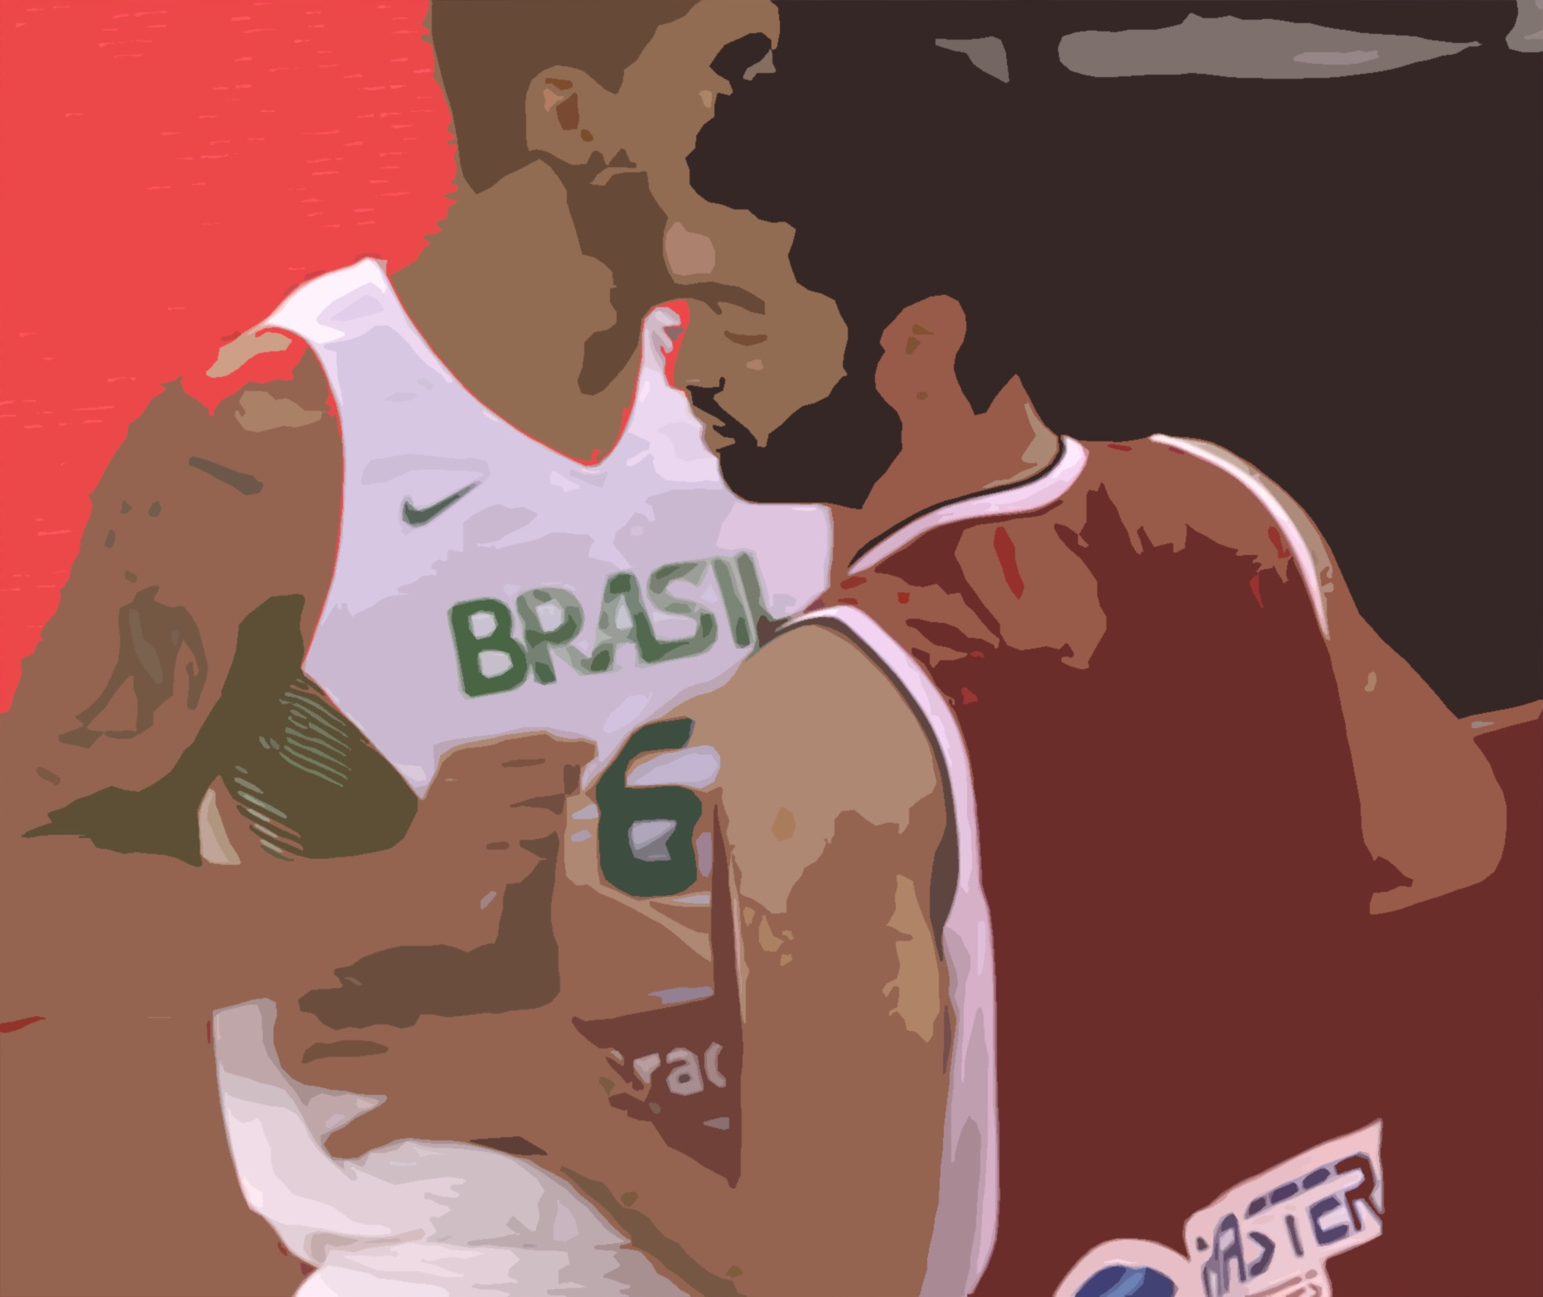
SIGNS OF FAKING
Faker is looking for contact first
Faker needs the contact to fake

Slide 14
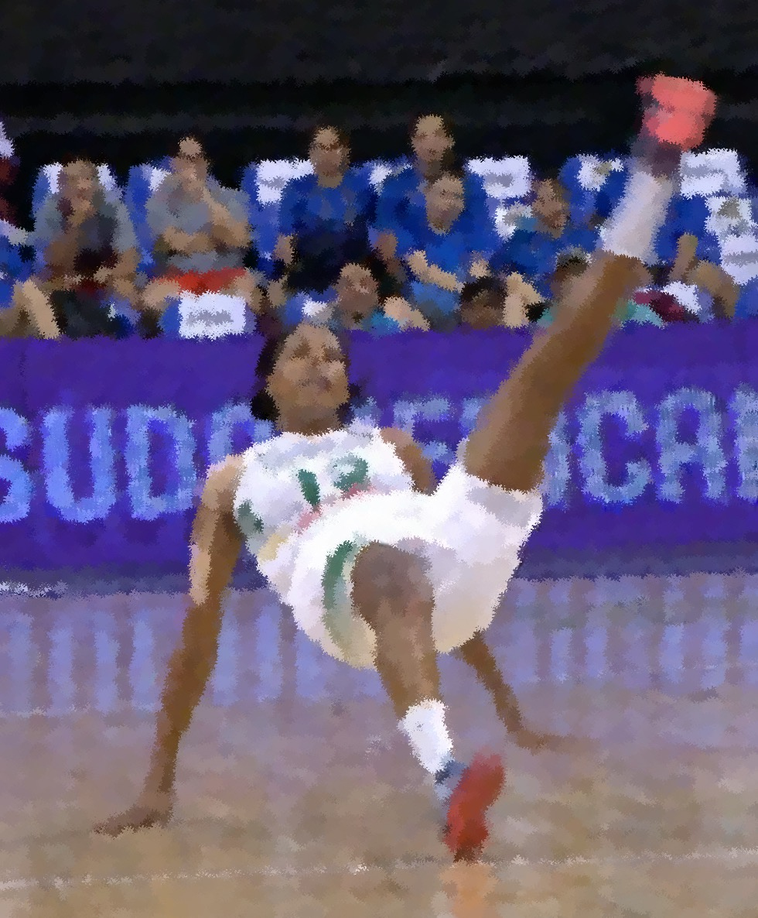
SIGNS OF FAKING
Head goes up / back (head fake) when contact does not occur in head
Jumping off spot & landing spot are close to each other
Making theatrical exaggerated movements.
Feet goes up when falling and hands are prepared for fall.

Slide 15
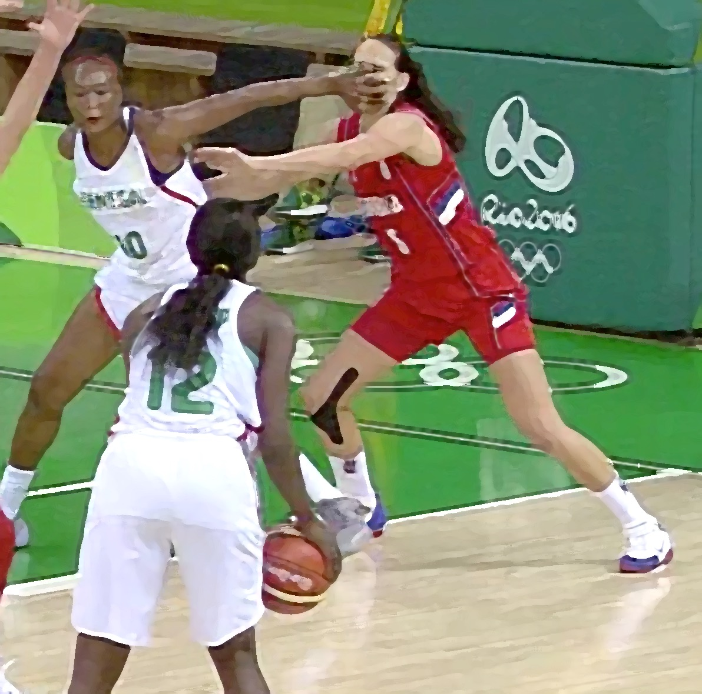
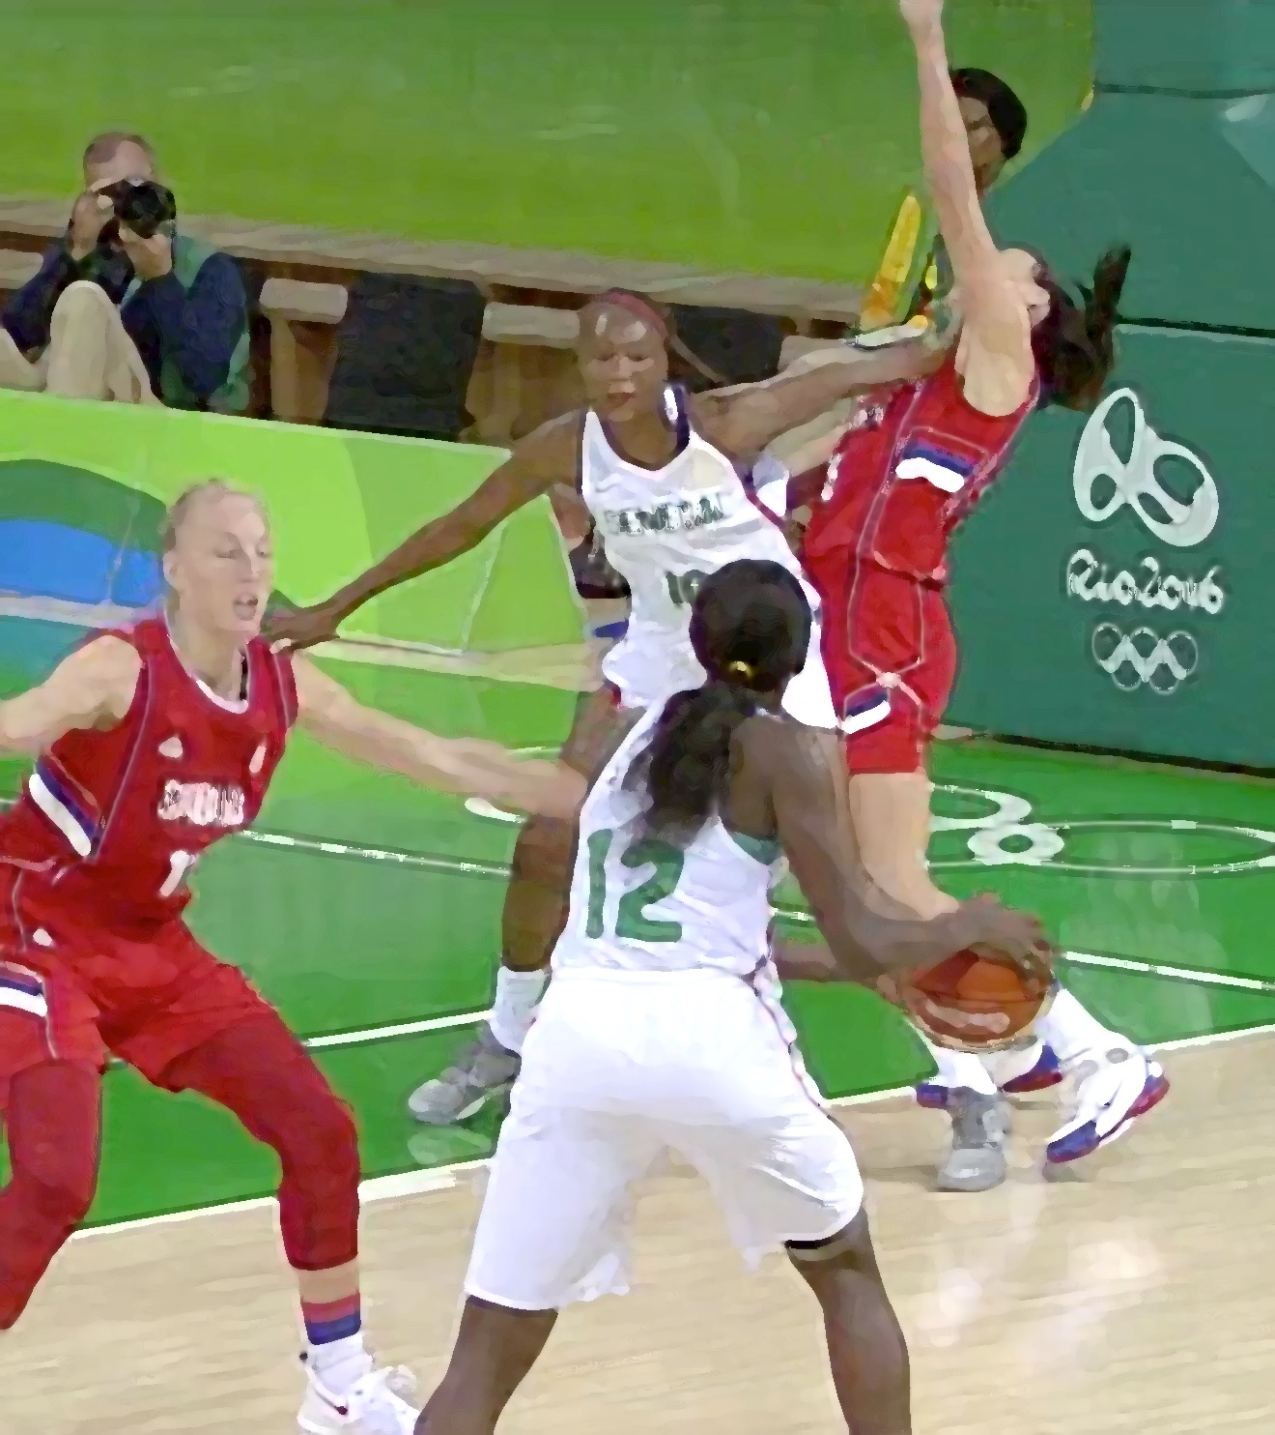
Not all contacts ARE FAKING
Not all the movements are FAKING TO BE FOULED
It is important to see the entire play,
not only the reaction of the player.
Illegal contact is still to be called as a foul,
marginal contacts are still part of the game and legal.

